Slide 1
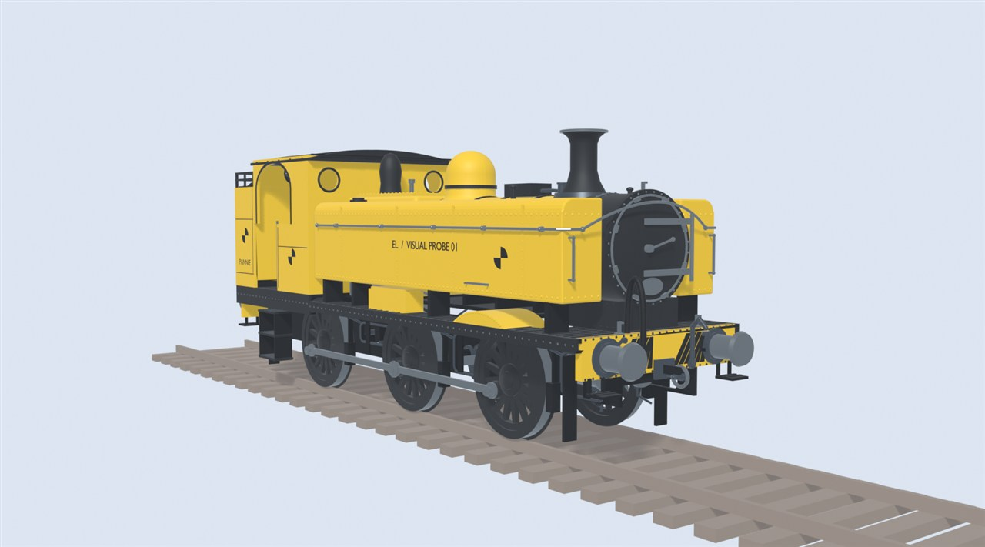
Early Locomotion
WELCOME
A steam railway mod for Satisfactory, explained for newcomers. Everything here is a plan, not a finished mod.
Early Locomotion project render. Early test model. Not final art.
1

Slide 2
How to read this guide
WELCOME
AGREED
Decided.
PROPOSED
Suggested, not confirmed.
PROVISIONAL
A test number that may change.
UNDECIDED
Still an open question.
BACKGROUND
A real-world fact.
Every idea carries a tag in the top-right corner.
2

Slide 3
The idea in one picture
WELCOME
AGREED
Cheap to build
Real limits:
speed, range, signals, stations
Your answers:
tenders, service stops, signal boxes
Later:
electric monorail
Early Locomotion project render. Early test model, not final art.
Cheap track and trains. Real limits. You solve them with coal, water, signals and planning.
3

Slide 4
What is Satisfactory?
THE GAME
BACKGROUND
Vanilla = the game without mods.
Belt
Miner
Smelter
Constructor
Storage
You
By Coffee Stain Studios. Full release 2024.
A first-person game about building factories. You mine, make and move materials until it all runs itself.
4

Slide 5
Where the mod fits
THE GAME
PROVISIONAL
Tier 6
Monorail: the game's electric trains
Tier 4 to 5
Heavy Steam
Tier 3 to 4
Railway Expansion
Tier 3
Early Steam Railways
Tiers and prerequisites:
PROVISIONAL
UNDECIDED (OQ01)
Technology unlocks in tiers. The mod adds steam railways early, before the game's electric trains.
5

Slide 6
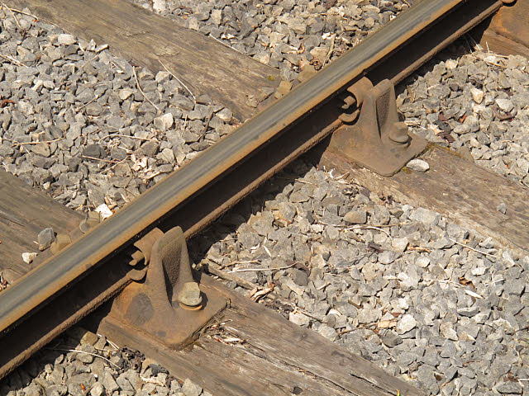
Track
STEAM RAILWAYS
BACKGROUND
Gauge: 1,435 mm on most railways
Rail
Sleeper
Photo: Stephen Craven, CC BY-SA 2.0, Wikimedia Commons.
Ballast
Two steel rails sit on sleepers over stone ballast. The sleepers keep the rails the right distance apart.
6

Slide 7
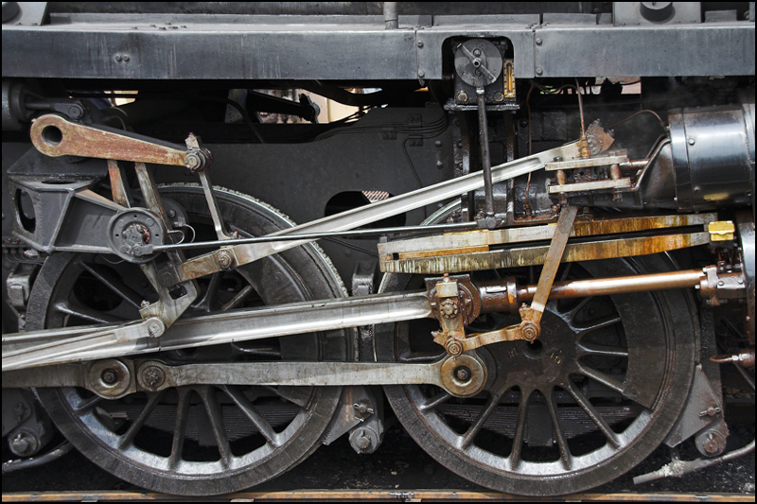
How a steam engine works
STEAM RAILWAYS
BACKGROUND
2
Steam
Exhaust
1
Fire
4
Wheels
3
Piston
Photo: Ben Salter, CC BY 2.0, Wikimedia Commons.
Coal heats water. Steam pushes pistons. Rods turn the wheels.
7

Slide 8
Coal, water and steam
STEAM RAILWAYS
AGREED
Before
After
Steam leaves the chimney. It is not used again.
One long trip
EMPTY FIRST
Coal
Water
Coal
Water
In the mod, water is usually the tighter limit.
AGREED
Steam is used once and lost. So water runs out first. Coal lasts longer.
8

Slide 9
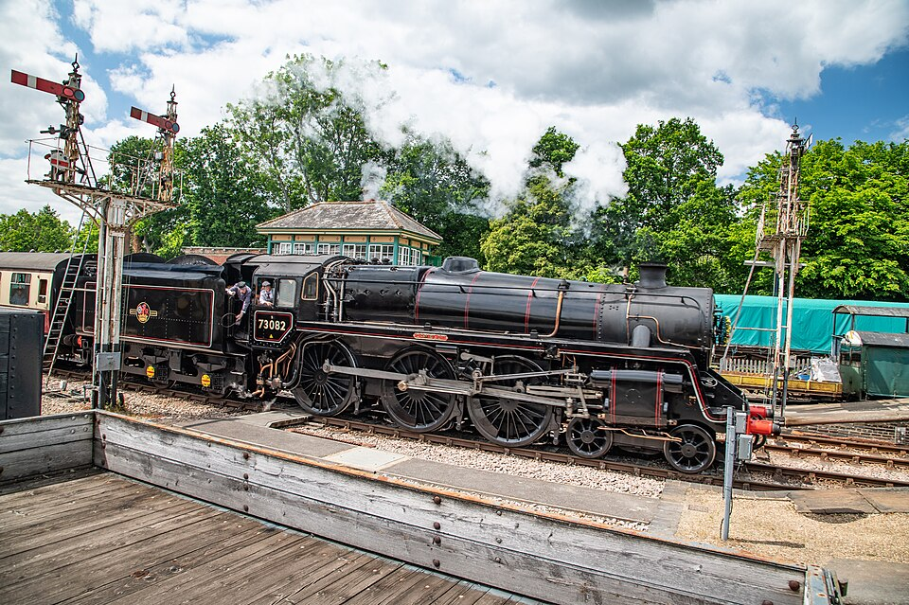
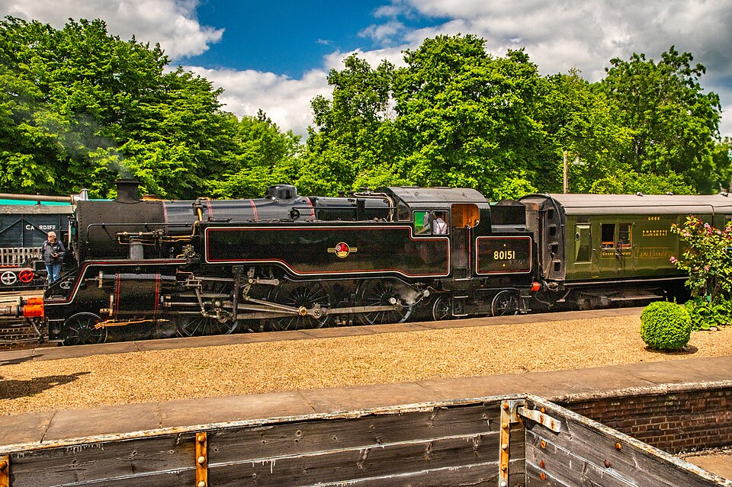
Tender or tank?
STEAM RAILWAYS
BACKGROUND
Tender engine
Tank engine
Tender: coal and water behind the cab
Side tanks: water.
Bunker: coal.
Photo: www.mgaylard.co.uk, CC BY 2.0, Wikimedia Commons.
Photo: www.mgaylard.co.uk, CC BY 2.0, Wikimedia Commons.
A tender engine pulls a coal and water wagon. A tank engine carries both itself.
9

Slide 10
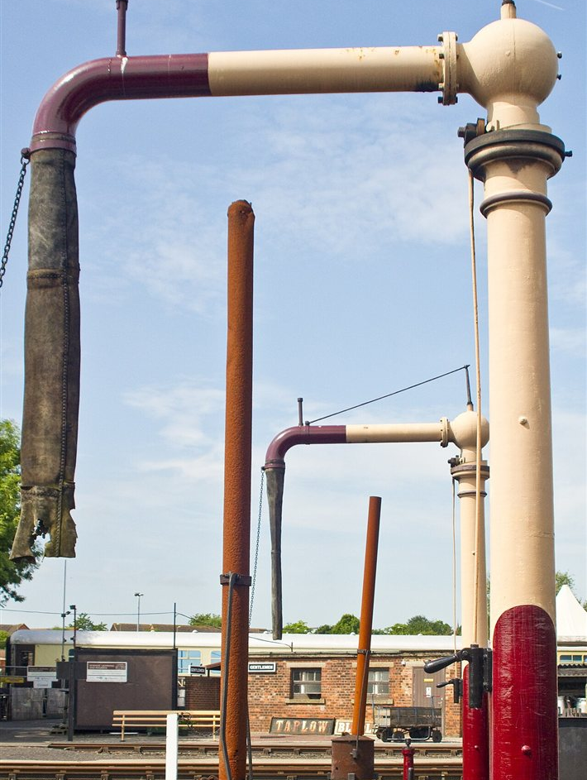
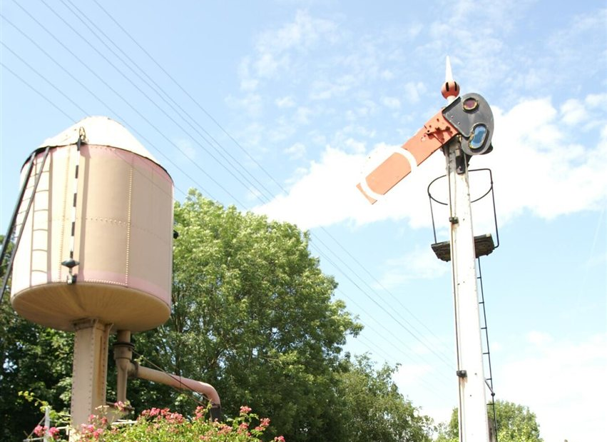
Taking on water
STEAM RAILWAYS
BACKGROUND
Arm swings over the hatch
Gravity
Photo: David Merrett, CC BY 2.0, Wikimedia Commons.
Photo: Barry Skeates, CC BY 2.0, Wikimedia Commons.
A water crane swings over the engine. Water flows down from a tank above.
10

Slide 11
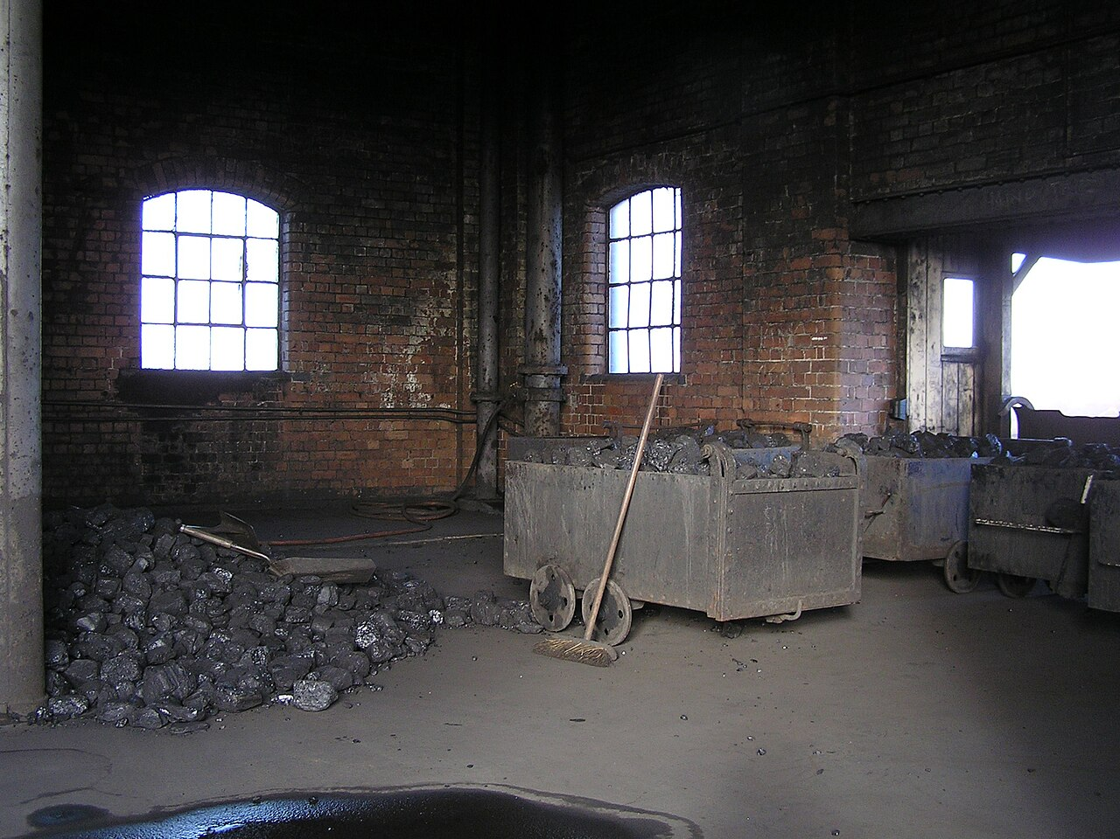
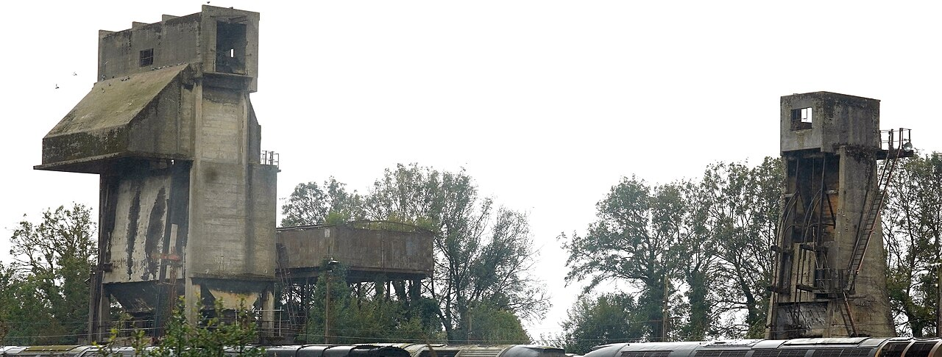
Taking on coal
STEAM RAILWAYS
BACKGROUND
Coal stage
Gravity
Coaling tower
Photo: Gillett's Crossing, CC BY 2.0, Wikimedia Commons.
Gravity
Photo: kitmasterbloke, CC BY 4.0, Wikimedia Commons.
Coal starts higher than the tender. A ramp or tower lets gravity fill it.
11

Slide 12
Why trains need signals
STEAM RAILWAYS
BACKGROUND
No warning: crash
STOP
CLEAR
Long stopping distance
Block 1
Block 2
Block 3
Trains cannot swerve. They need a long way to stop. Signals keep them apart.
12

Slide 13
Words you will meet
STEAM RAILWAYS
BACKGROUND
Vanilla
The game without mods.
Tier
A step of unlocks.
Wagon
A vehicle that carries cargo.
Tender
A coal and water wagon behind an engine.
Block
A stretch of track that holds one train.
Semaphore
A signal with a moving arm.
Signal box
Where a signaller works the signals.
Service stop
A stop to refill coal and water.
Short meanings for the words in this guide.
13

Slide 14
Not "trains, but earlier"
THE MOD'S IDEA
AGREED
Vanilla electric (later)
Early steam (this mod)
Monorail beam
Two-rail track
Electricity
Coal and water
No refuelling
Service stops
Block and path
Semaphores and boxes
Compact
Large
Steam rail is not electric trains with an early unlock. It works in its own way.
14

Slide 15
Every limit has an answer
THE MOD'S IDEA
AGREED
Auxiliary tender
Short range
Service stop
Bigger engine
Small loads
A suitable engine and train length
Busy line
More signals and boxes
Slow overall
Convert to monorail later
Short range, small loads, a busy line, slow trips: each has a fix.
15

Slide 16
Why steam stays behind electric
THE MOD'S IDEA
AGREED
Cheap to start
Steam
Electric
Speed
Steam gets there first. Electric wins when the network matures.
Throughput
Traffic density
Convenience
Shape only. Not measured.
Steam is cheap and early. Electric wins on speed, throughput, traffic and convenience.
16

Slide 17
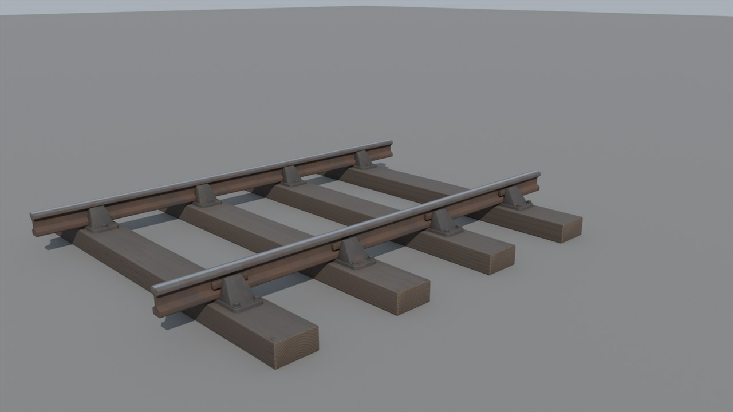
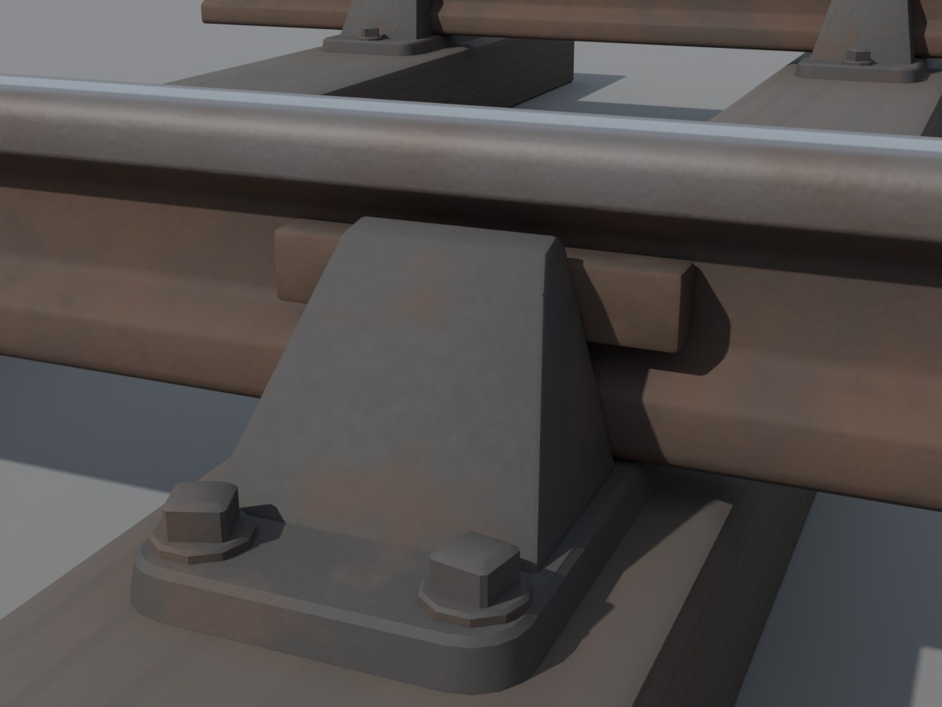
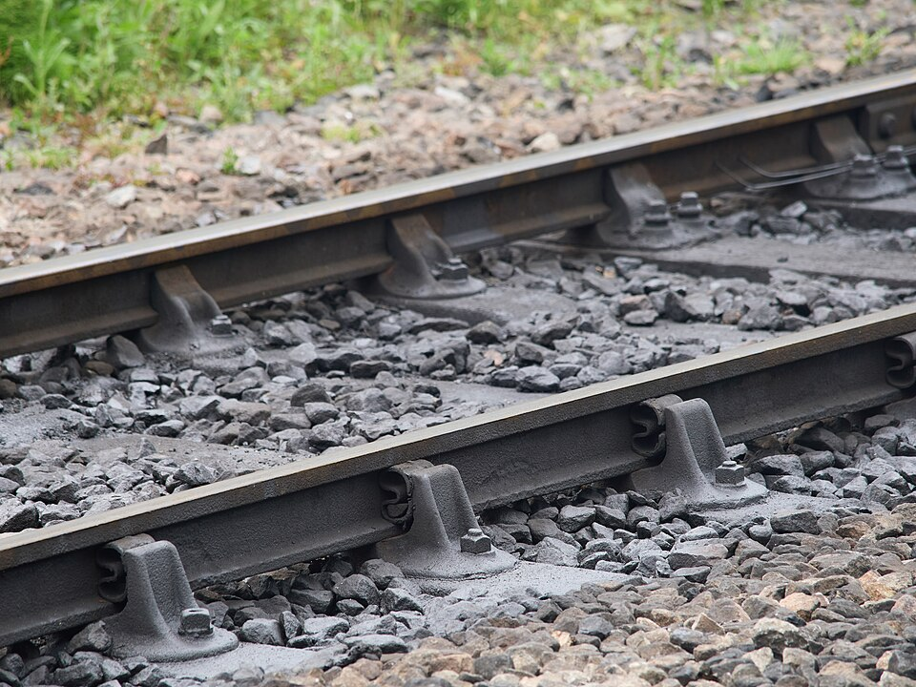
The mod's track
THE MOD'S IDEA
AGREED
Early Locomotion project render. Early test model, not final art.
Close-up: chairs and rails
Photo: James E. Petts, CC BY-SA 4.0, Wikimedia Commons.
Early Locomotion project render. Early test model, not final art.
Real railway, for comparison
Speed = lowest of: track limit, signal limit, engine limit
PROPOSED
Longest track piece:
UNDECIDED (OQ02)
Two thin rails on sleepers, built from iron plates and rods. Speed is the lowest of three limits.
17

Slide 18
Three roles
LOCOMOTIVES
AGREED
Small
Medium
Large
Haul
Haul
Haul
Speed
FASTEST? UNDECIDED
Speed
Speed
Range
Range
Range
Servicing needs
Servicing needs
Servicing needs
Local branches
Fast mixed freight
Heavy freight
Shape only. Not measured.
Small, Medium and Large each have a job. Bigger is not simply better.
18

Slide 19
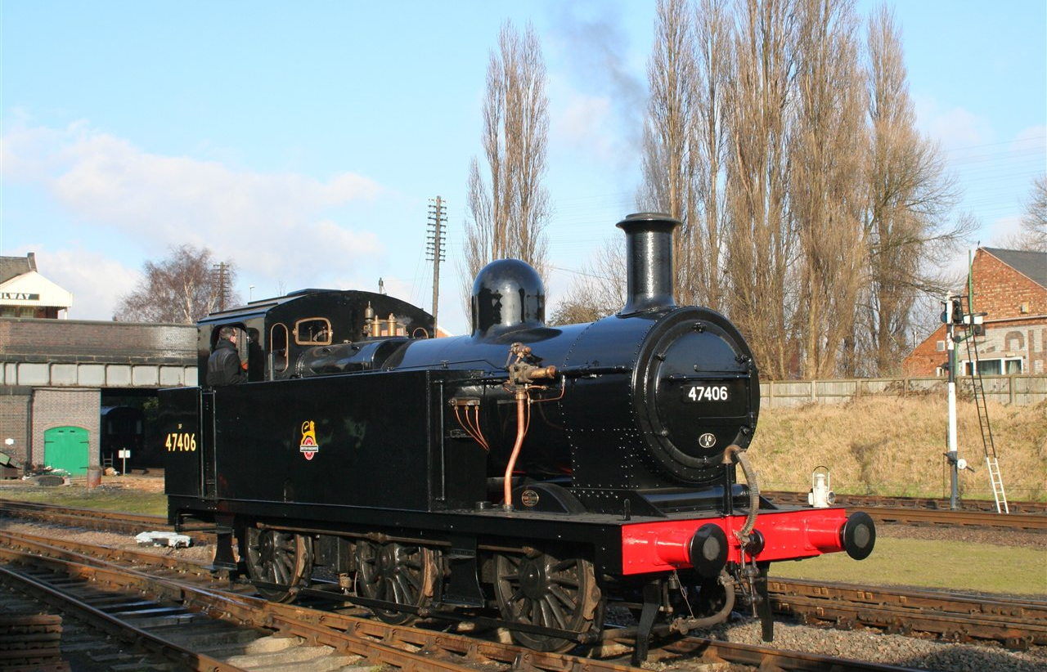
Small: the branch-line tank
LOCOMOTIVES
AGREED
No tender
Weakest hauler
Cheap to run
Struggles with long trains and hills
PROPOSED
Photo: Duncan Harris, CC BY-SA 2.0, Wikimedia Commons.
A related Fowler tank engine (a Jinty). The design's reference, the Dock Tank, has no survivor.
Small carries its own coal and water. It is cheap, light and best on short branches.
19

Slide 20
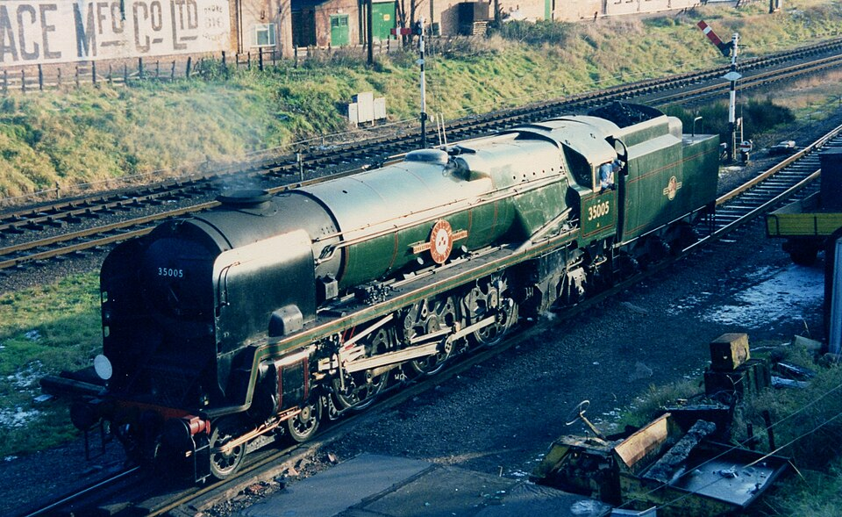
Medium: the long-range runner
LOCOMOTIVES
AGREED
Normal tender: more coal and water
Burns more
Auxiliary tender: a practical extra
Fastest class
Photo: kitmasterbloke, CC BY 2.0, Wikimedia Commons.
PROPOSED
UNDECIDED (OQ05)
Reference: Merchant Navy class
Medium has a tender and more range. It uses more coal and water. It may be the fastest class.
20

Slide 21
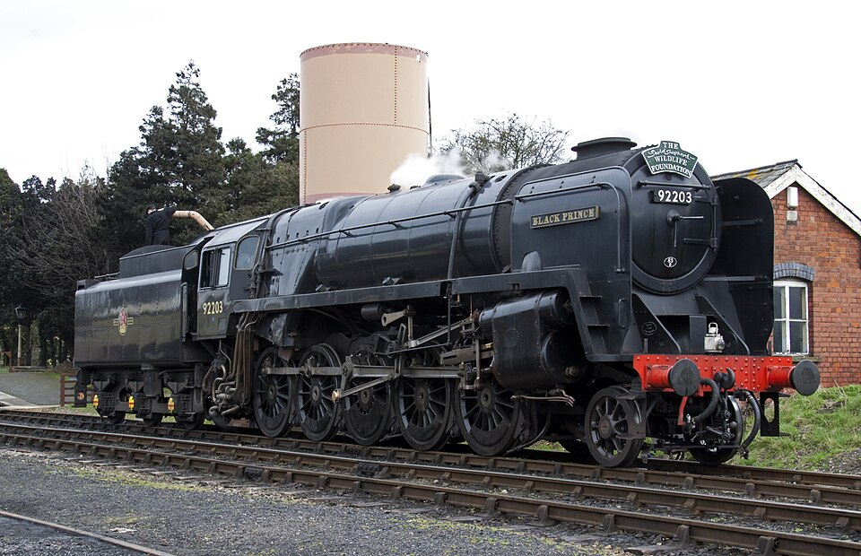
Large: the heavy hauler
LOCOMOTIVES
AGREED
Most powerful
High coal and water demand
Auxiliary tender for very long routes
Slower to speed up
PROPOSED
Photo: Tony Hisgett, CC BY 2.0, Wikimedia Commons.
Reference: BR Standard 9F
Large pulls the heaviest trains. It is thirsty and slow to speed up. It suits heavy freight.
21

Slide 22
Wagons
LOCOMOTIVES
PROVISIONAL
Steam wagon: about 20 stacks
Vanilla wagon: 32 stacks
PROVISIONAL
Stack = a pile of one item.
Wagon catalogue:
UNDECIDED
Steam wagons are cheaper and hold less. About 20 item stacks, against 32 in a vanilla wagon.
22

Slide 23
How far can an engine go?
LOCOMOTIVES
AGREED
Route-dependent targets
PROVISIONAL
Range left
 | Water (km) | Coal (km)
Small | 2–3 | 4–5
Medium | 4–5 | about 7
Large | 6–7 | about 10
Compacted Coal burns more efficiently.
AGREED DIRECTION
AGREED
Range comes from real tank sizes and real use. Hills and heavy loads use more. Coasting uses less.
23

Slide 24
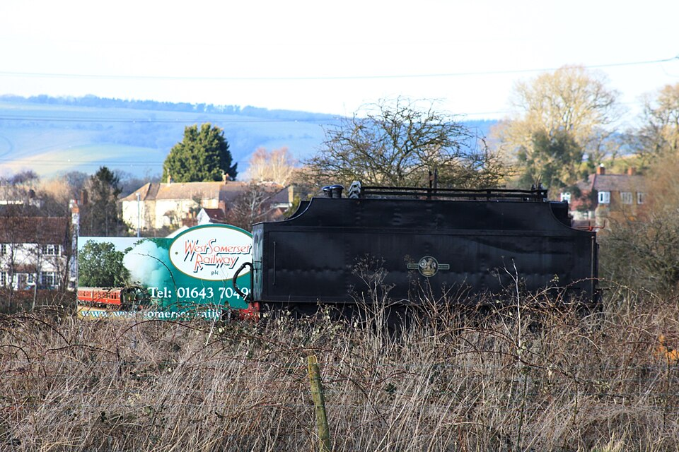
Tenders
LOCOMOTIVES
AGREED
A real tender, for illustration
One vehicle
Auxiliary tender: a separate wagon
PROPOSED
WATER ONLY
COAL AND WATER
Carries no freight
Adds weight
Photo: Geof Sheppard, CC BY-SA 4.0, Wikimedia Commons.
A normal tender belongs to the engine. An auxiliary tender is an extra wagon: more range, less pulling power.
24

Slide 25
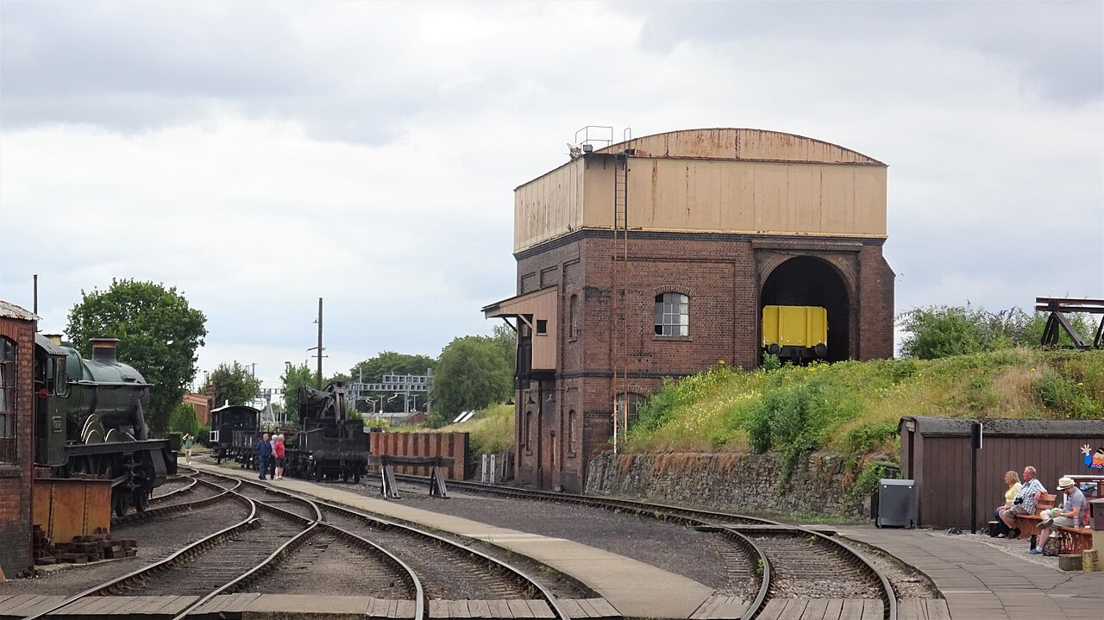
A steam station
STATIONS
AGREED
Pipe: water in
Photo: Rosser1954, CC BY-SA 4.0, Wikimedia Commons.
Conveyor: coal in
Coal bunker
Water hatch
Platform and cargo loading
Signal box
Vanilla station (for comparison)
Large footprint. Exact size undecided.
A steam station is big. It has a water tower, coal loading, a signal box and a platform.
25

Slide 26
Servicing takes time
STATIONS
AGREED
1
2
3
4
5
Approach slowly
Settle into dock
Long steam hiss
Coal chutes in
Water arm swings
PROPOSED
9
8
7
6
Depart
Folds away
Wait while it fills
Finds the hatches
Empty tanks
Rates and times:
Small top-up
PROPOSED
PROVISIONAL
The machinery finds each engine's hatches. Servicing takes visible time. Then it folds away.
26

Slide 27
Service points
STATIONS
PROPOSED
PROPOSED
PROPOSED
PROPOSED
PROPOSED
Water Tower
Coaling Stage
Steam Service Point
Full Station
Mine
Water stop
Water and coal stop
Factory
Separate coal and water stops make long routes possible. Not every stop needs a full station.
AGREED
27

Slide 28
Blocks: one train at a time
SIGNALS
AGREED
One block
Waits
STOP
CLEAR
CLEAR
Block A: occupied
Block B: occupied
Block C: free
Block D: free
Arm flat: stop
Arm raised: go
Signals split the track into blocks. Only one train may be in a block. The next train waits.
28

Slide 29
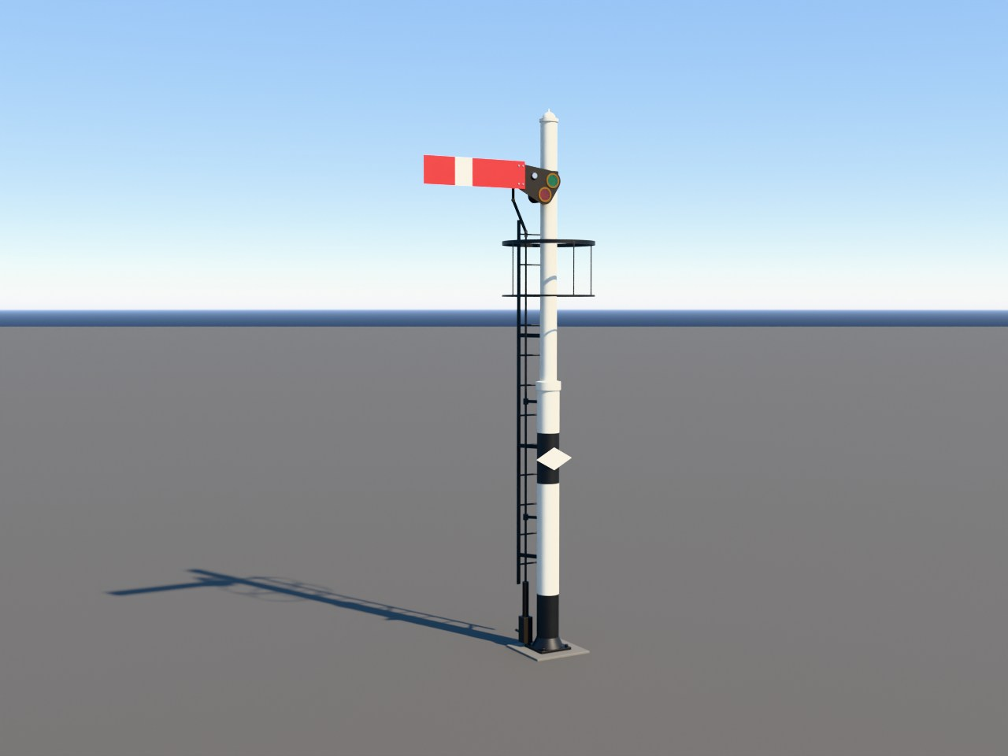
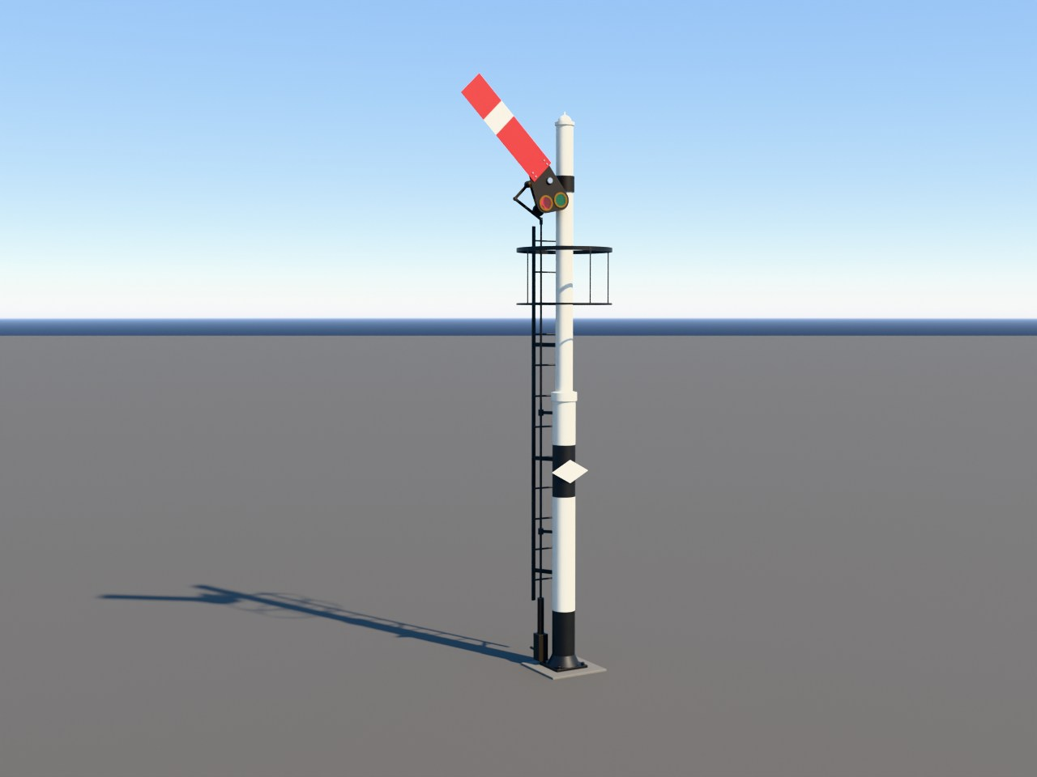
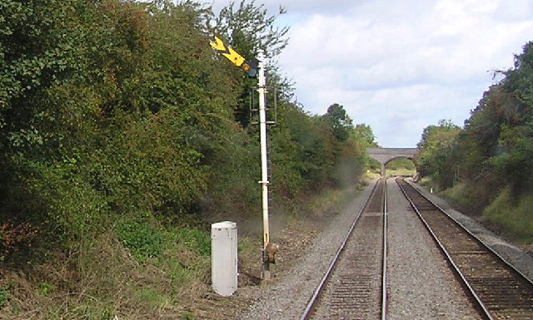
Semaphore signals
SIGNALS
AGREED
ARM STYLE: UNDECIDED
Distant signal
STOP: arm flat
CLEAR: arm raised
Be ready to stop at the next signal
Next signal is clear
Early Locomotion project render. Early test model, not final art.
Blender model, not yet in the game.
Early Locomotion project render. Early test model, not final art.
Blender model, not yet in the game.
Photo: Richard Dunn, CC BY-SA 2.0, Wikimedia Commons.
Arm flat means stop. Arm raised means go. On real railways, a broken wire drops the arm to stop.
29

Slide 30
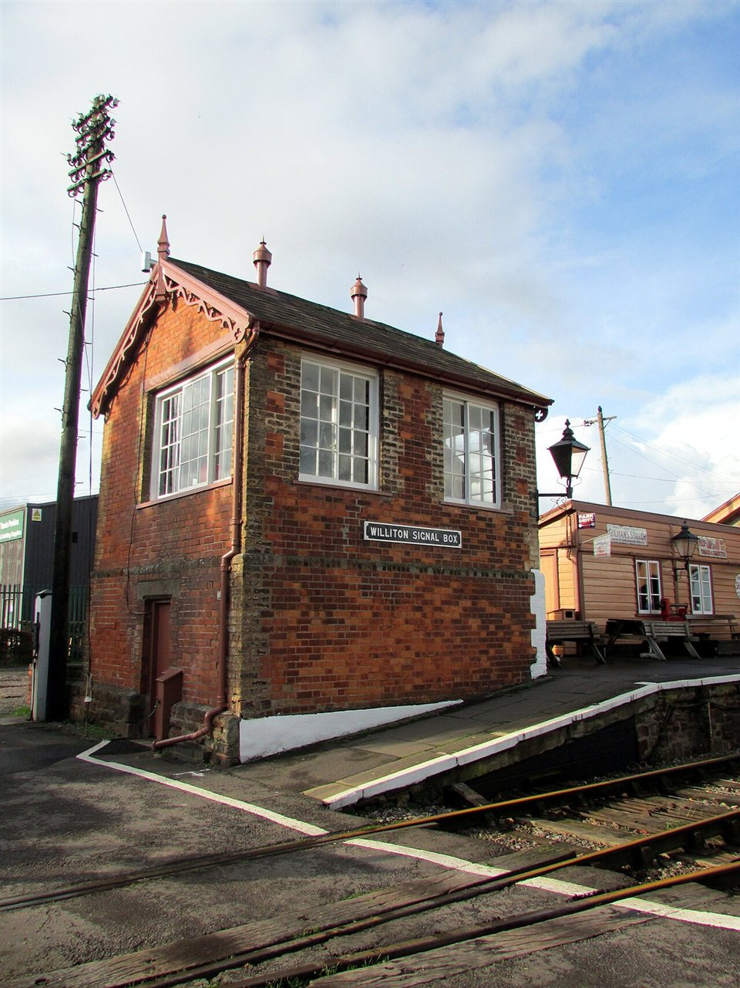
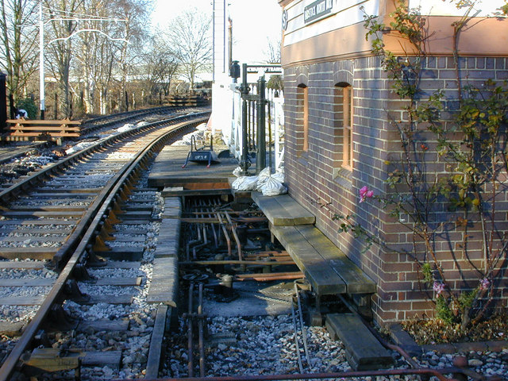
The signal box
SIGNALS
AGREED
Operating floor
Levers are locked so two clashing signals cannot both be clear
Example colours only
Stop
Distant
Points
Lock
Locking room
Rods and wires run out to signals and points
Photo: Nigel Brown, CC BY-SA 2.0, Wikimedia Commons.
Photo: Reading Tom, CC BY 2.0, Wikimedia Commons.
A signaller pulls levers. Rods and wires carry the movement out to the signals.
30

Slide 31
How it works together
SIGNALS
AGREED
Bell codes
Box territory: limited
STOP
CLEAR
CLEAR
Block 1
Block 2
Block 3
1
Train in block
2
Signal at STOP
3
Train leaves
4
Lever pulled: arm lifts
In the mod: no player wiring.
AGREED
The signaller watches the blocks, sets the signals and keeps trains apart.
31

Slide 32
Early limits
SIGNALS
PROVISIONAL
Block length
Speed cap
Signals per box
Box reach
about 400 to 500 m
about 60 km/h
6 to 8 (station box), 12 to 16 (dedicated box)
about 1 to 1.5 km of track
PROVISIONAL
PROVISIONAL
PROVISIONAL
PROVISIONAL
0 m
450 m
900 m
1,350 m
1,800 m
2,250 m
Block lengths and speed caps:
UNDECIDED (OQ03)
Early signals have limits: short blocks, a speed cap and a limited number per box. Numbers are provisional.
32

Slide 33
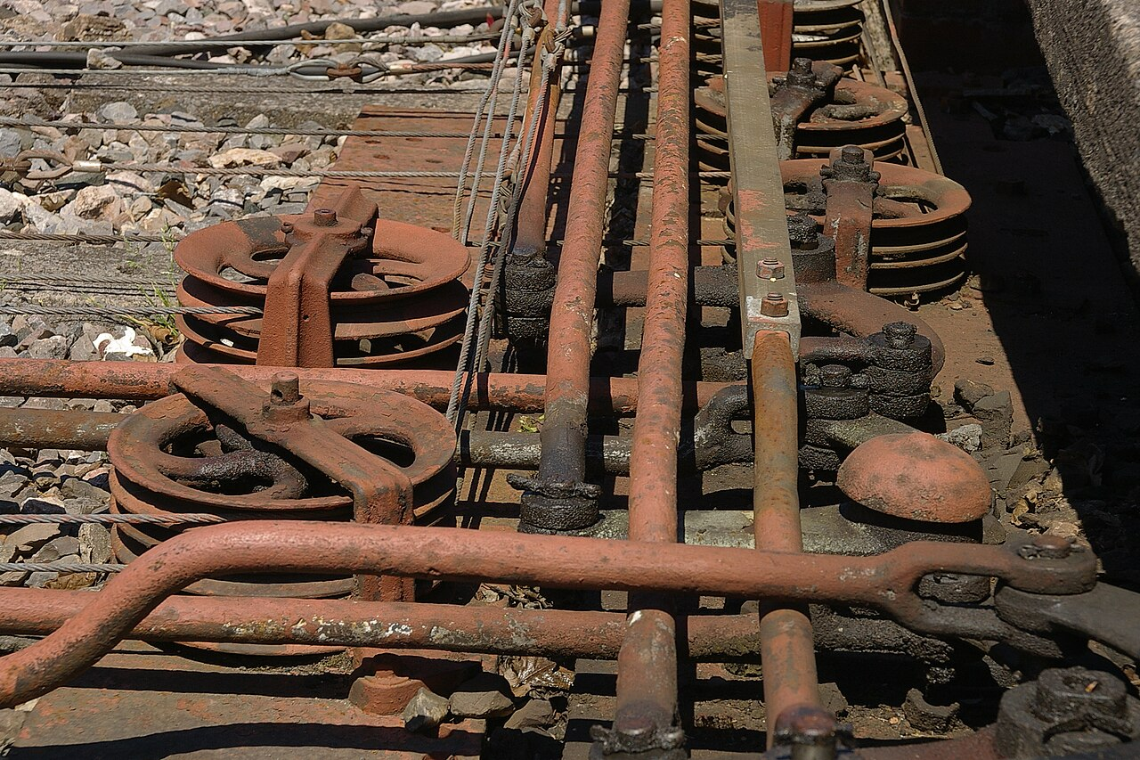
No wiring for you
SIGNALS
AGREED
ROD OR WIRE LOOK: UNDECIDED (OQ04)
Place signals on connected track
1
A box with room takes control
2
Rods and wires draw themselves
3
Box screen: signals, state, capacity, reach.
Photo: mattbuck (category), CC BY-SA 3.0, Wikimedia Commons.
Boxes take control of connected signals automatically. Rods and wires are drawn for you, as a visual layer.
33

Slide 34
Later signals and manual control
SIGNALS
AGREED
Start: semaphore blocks
AUTO
YARD
MAINLINE
AGREED
Later: better semaphore or interlocking
PROPOSED
Mature: electronic signals like vanilla
PROPOSED
Pick a destination and let the game set points:
PROPOSED
Better signals come later. Drivers can also set points from a simple track diagram.
34

Slide 35
Upgrading to the monorail
LATER
AGREED
Before
Upgrade
PROPOSED
Mixed network
PROPOSED
Steam trains cannot use this section
Interchange
(possible Transfer Station: undecided)
Steam trains cannot move directly between the two track types.
AGREED
Upgrade steam track in place. The route stays. Steam trains cannot use the converted part.
35

Slide 36
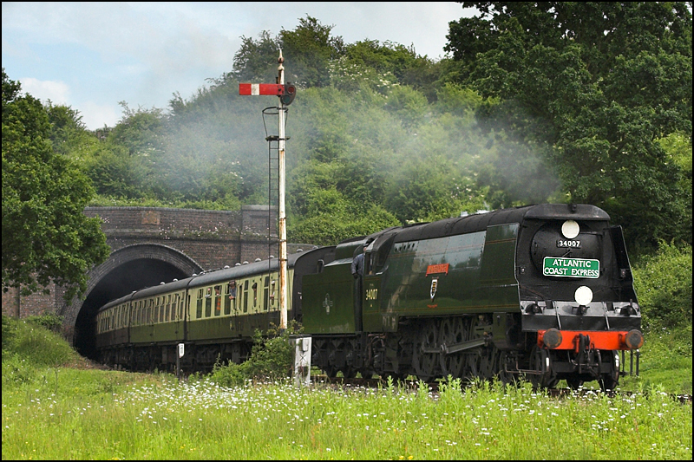
After launch
LATER
PROPOSED
PROPOSED
PROPOSED
Late-steam infrastructure
Advanced manual driving (optional)
PROPOSED
PROPOSED
Regional packs
More locomotives
Core 1.0: a complete game
Photo: Ben Salter, CC BY 2.0, Wikimedia Commons.
AGREED
Real British locomotives like this could appear.
Which locomotives:
UNDECIDED (OQ20)
After launch, optional packs could add locomotives, regional looks and deeper driving. The core game stays complete.
36

Slide 37
Regions and running numbers
EXTRAS
AGREED
British
No. 1234
North American
Continental European
Visible number
Examples only. Launch regions:
Fleet ID: hidden, never changes
UNDECIDED (OQ06)
Changing region restyles Core stock. Migration:
UNDECIDED
The world picks a regional style. Each engine has a hidden permanent ID and a number you can change.
37

Slide 38
Your railway guide
EXTRAS
AGREED
Short caption here
PROPOSED
A playful takeover when you first unlock rail
A friendly railway guide teaches with short animated lessons. Lessons are optional and can be replayed.
38

Slide 39
Where we are
STATUS
PROVISIONAL
Plans can change.
PROVISIONAL
Under way
Early Locomotion project render. Early test model, not final art.
Early Locomotion project render. Early test model, not final art.
Planned
Engine
Rolling stock
Track
Stations
Signals
Unlocks
Tutorials
Release 1.0: singleplayer
Later: multiplayer
A test engine runs on the game's real rails. Next come the other railway pieces. Singleplayer first. Multiplayer after release.
39

Slide 40
Still undecided
STATUS
UNDECIDED
UNDECIDED
UNDECIDED
UNDECIDED
UNDECIDED
Exact unlock tiers (OQ01)
Longest track piece (OQ02)
Block lengths and speed caps (OQ03)
How boxes measure their reach (OQ04)
UNDECIDED
UNDECIDED
UNDECIDED
UNDECIDED
Is Medium the fastest? (OQ05)
Which regions at launch? (OQ06)
Which extra locomotives? (OQ20)
Pricing and release of packs (OQ26)
These questions are open. Nothing here has been chosen yet.
40

Slide 41
Image credits (1 of 2)
CREDITS
Slot | Slide | Author | Licence | Source
P01 | 6 | Stephen Craven | CC BY-SA 2.0 | Wikimedia Commons
P02 | 17 | James E. Petts | CC BY-SA 4.0 | Wikimedia Commons
P03 | 7 | Ben Salter | CC BY 2.0 | Wikimedia Commons
P04 | 9 | www.mgaylard.co.uk | CC BY 2.0 | Wikimedia Commons
P05 | 9 | www.mgaylard.co.uk | CC BY 2.0 | Wikimedia Commons
P06 | 10 | Barry Skeates | CC BY 2.0 | Wikimedia Commons
P07 | 10 | David Merrett | CC BY 2.0 | Wikimedia Commons
P08 | 11 | Gillett's Crossing | CC BY 2.0 | Wikimedia Commons
P09 | 11 | kitmasterbloke | CC BY 4.0 | Wikimedia Commons
P10 | 19 | Duncan Harris | CC BY-SA 2.0 | Wikimedia Commons
P11 | 20 | kitmasterbloke | CC BY 2.0 | Wikimedia Commons
P12 | 21 | Tony Hisgett | CC BY 2.0 | Wikimedia Commons
CC BY-SA photos are shown unmodified except for resizing.
Photographs come from Wikimedia Commons under Creative Commons licences.
41

Slide 42
Image credits (2 of 2)
CREDITS
Slot | Slide | Author | Licence | Source
P13 | 29 | Richard Dunn | CC BY-SA 2.0 | Wikimedia Commons
P14 | 30 | Reading Tom | CC BY 2.0 | Wikimedia Commons
P15 | 30 | Nigel Brown | CC BY-SA 2.0 | Wikimedia Commons
P16 | 33 | mattbuck (category) | CC BY-SA 3.0 | Wikimedia Commons
P17 | 25 | Rosser1954 | CC BY-SA 4.0 | Wikimedia Commons
P18 | 24 | Geof Sheppard | CC BY-SA 4.0 | Wikimedia Commons
P19 | 36 | Ben Salter | CC BY 2.0 | Wikimedia Commons
R01 | 1, 3, 39 | Early Locomotion project (test model, not final art) | No third-party licence | Project render
R02 | 17, 39 | Early Locomotion project (test model, not final art) | No third-party licence | Project render
R03 | 29 | Early Locomotion project (test model, not final art) | No third-party licence | Project render
R04 | 29 | Early Locomotion project (test model, not final art) | No third-party licence | Project render
R05 | 17 | Early Locomotion project (test model, not final art) | No third-party licence | Project render
CC BY-SA photos are shown unmodified except for resizing.
Mod renders belong to the project. They show early test models.
42

